Slide 1

Developing Infrastructure as Code with Terraform, 2nd Edition
Robert Jordan
Author, Trainer
System Architect
Notes:
For your Author Photo, right-click it and select Format Picture. Then select Picture Color and turn the Saturation down to 0%.

Slide 2
Course Overview
Introduction to Infrastructure as Code
Terraform Basics
Using Terraform in Production
Notes:
For your Author Photo, right-click it and select Format Picture. Then select Picture Color and turn the Saturation down to 0%.

Slide 3
Lesson 1: Say Hello to Terraform
1.1 Setting up your development environment
1.2 Downloading the example code
1.3 Applying your first Terraform
Notes:
For your Author Photo, right-click it and select Format Picture. Then select Picture Color and turn the Saturation down to 0%.

Slide 4
Lesson 1: Say Hello to Terraform
1.1 Setting up your development environment
Notes:
For your Author Photo, right-click it and select Format Picture. Then select Picture Color and turn the Saturation down to 0%.

Slide 5
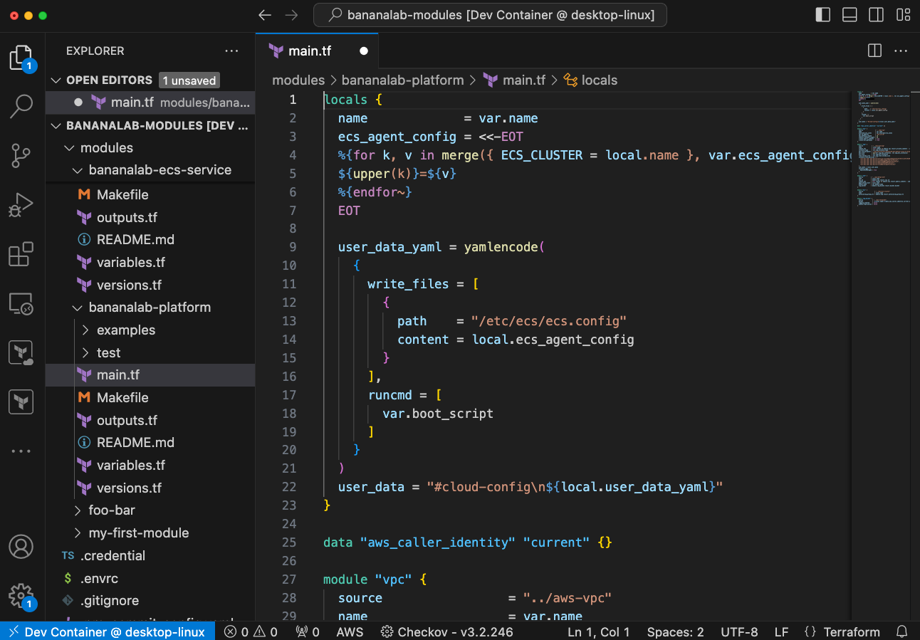
Demo: Setup Development Environment

Slide 6
Lesson 1: Say Hello to Terraform
1.2 Downloading the example code
Notes:
For your Author Photo, right-click it and select Format Picture. Then select Picture Color and turn the Saturation down to 0%.

Slide 7
Demo: Download Example Code

Slide 8
Lesson 1: Say Hello to Terraform
1.3 Applying your first Terraform
Notes:
For your Author Photo, right-click it and select Format Picture. Then select Picture Color and turn the Saturation down to 0%.

Slide 9
Demo: Hello Terraform

Slide 10
Lesson 2: Introduce Infrastructure as Code
2.1 Beginning with a look back: How did we get here?
2.2 Deciding why you should use Infrastructure as Code
2.3 Learning definitions
2.4 Exploring approaches to IaC
2.5 Understanding the software development lifecycle and IaC
Notes:
For your Author Photo, right-click it and select Format Picture. Then select Picture Color and turn the Saturation down to 0%.

Slide 11
Lesson 2: Introduce Infrastructure as Code
2.1 Beginning with a look back: How did we get here?
Notes:
For your Author Photo, right-click it and select Format Picture. Then select Picture Color and turn the Saturation down to 0%.

Slide 12
Infrastructure Paradigms
 | 1960s | 1970s | 1980s | 1990s | 2000s | 2010s | 2020s
Mainframe
Client/Server
Distributed
Virtual
Cloud

Slide 13
Mainframe Era
Centralized
Local
Infrequent changes

Slide 14
Client / Server
Centralized Servers
Networked Workstations
Infrequent changes

Slide 15
Distributed
Many Servers
"Cattle, not pets"
Configuration Management

Slide 16
Virtual
Servers within servers
May be short lived

Slide 17
Cloud
Fully decoupled from physical infrastructure
API Driven
You are here!

Slide 18
Lesson 2: Introduce Infrastructure as Code
Why Infrastructure as Code?
Notes:
For your Author Photo, right-click it and select Format Picture. Then select Picture Color and turn the Saturation down to 0%.

Slide 19
Why Infrastructure as Code?
Consistency and Standardization
Automation and Speed
Version Control and Collaboration
Scalability and Flexibility
Cost Efficiency
Security and Compliance
Disaster Recovery
Testing and Validation
Notes:
1. Consistency and Standardization
Elimination of Configuration Drift: IaC ensures that environments are consistent across development, testing, and production by applying the same configurations through code.
Standardization: Infrastructure configurations are standardized, reducing the chances of errors or deviations between environments.
2. Automation and Speed
Automated Provisioning: IaC automates the provisioning of infrastructure, reducing the time and effort required to set up and manage resources.
Rapid Deployment: Changes can be applied quickly and consistently across environments, leading to faster development cycles and quicker time-to-market.
3. Version Control and Collaboration
Track Changes: Infrastructure configurations can be stored in version control systems (e.g., Git), enabling tracking of changes, rollback to previous versions, and better collaboration among teams.
Collaboration: Teams can work together on infrastructure code, review changes, and ensure best practices are followed.
4. Scalability and Flexibility
Scalability: IaC makes it easier to scale infrastructure up or down based on demand by simply modifying the code and redeploying.
Reusable Modules: Infrastructure code can be modularized and reused, making it easier to manage complex environments.
5. Cost Efficiency
Optimized Resource Allocation: IaC helps in better resource management by enabling automated scaling and de-scaling, which can lead to cost savings.
Reduced Human Error: Automation reduces the likelihood of manual errors, which can be costly to rectify.
6. Improved Security and Compliance
Security as Code: Security practices can be integrated into IaC, ensuring that security configurations are consistent and up-to-date across all environments.
Compliance: IaC makes it easier to audit and ensure compliance with industry standards by maintaining a record of infrastructure configurations.
7. Disaster Recovery
Automated Recovery: In case of a failure, IaC allows for the quick rebuilding of infrastructure by applying the code, minimizing downtime and improving reliability.
8. Testing and Validation
Pre-deployment Testing: Infrastructure configurations can be tested in staging environments before deployment, reducing the risk of issues in production.
Validation Tools: Tools like Terraform, Ansible, and CloudFormation offer built-in validation, ensuring that configurations are syntactically correct and functional.

Slide 20
Lesson 2: Introduce Infrastructure as Code
2.3 Learning definitions
Notes:
For your Author Photo, right-click it and select Format Picture. Then select Picture Color and turn the Saturation down to 0%.

Slide 21
What is Infrastructure as Code?
Software engineering practice in which infrastructure management is automated through code rather than manual processes.
Configuration and management of infrastructure components—such as servers, networks, databases, and storage—are defined in code files that can be versioned, tested, and reused.

Slide 22
What is Configuration Management?
Configuration and management of software, such as operating systems, databases or server software are defined in code files that can be versioned, tested, and reused.

Slide 23
What is VCS?
Manages changes to code over time.
Tracks the history of changes, allowing multiple people to collaborate on a project, revert to previous versions, and maintain a record of modifications.
VCS is essential in software development, content management, and other fields where maintaining a history of changes is critical.

Slide 24
Idempotency
The property of operations to produce the same result no matter how many times they are applied.
An operation is considered idempotent if executing it multiple times has the same effect as executing it just once.

Slide 25
Terraform Core
The central part of Terraform, responsible for the orchestration of infrastructure management.
Handles the execution of Terraform's main functions, including reading configuration files, managing state, generating execution plans, and applying changes to infrastructure.

Slide 26
Terraform State
A database (file) that tracks the infrastructure resources managed by your Terraform configurations.
Acts as a source of truth for Terraform, allowing it to understand the current state of your infrastructure and compare it to your desired state defined in your configuration files.

Slide 27
Terraform Provider
Plugins that enable Terraform to interact with external APIs and services to manage and provision infrastructure resources.
Providers act as a bridge between Terraform and the various services or platforms you want to manage, such as cloud providers, SaaS platforms, or even on-premises systems.
Hosted in registries.
Native binaries written in Go.

Slide 28
State Backend
Remote storage for state database (file)
Usually “bucket” storage
Supports locking
Many providers:
S3
GCS
Azure
Terraform cloud

Slide 29
Dependency Graph
Representation that defines the relationships and dependencies between various resources in an infrastructure configuration.
Allows Terraform to determine the correct order in which resources should be created, modified, or destroyed.

Slide 30
Lesson 2: Introduce Infrastructure as Code
2.4 Exploring approaches to IaC
Notes:
For your Author Photo, right-click it and select Format Picture. Then select Picture Color and turn the Saturation down to 0%.

Slide 31
Approaches to IaC
Imperative
Focuses on how to achieve the desired state of the infrastructure.
Specifies a sequence of commands or steps that the IaC tool must execute to reach the desired outcome.

Slide 32
Approaches to IaC
Declarative
Focuses on what the desired state of the infrastructure should be, rather than detailing the specific steps to achieve that state.
Defines the final outcome, and the IaC tool determines how to achieve that outcome.

Slide 33
Declarative vs. Imperative
 | Declarative | Imperative
Focus | What the final state should be | How to achieve the final state
Control | Tool decides how to reach the desired state | User specifies the exact steps
Complexity | Simpler, especially for large environments | More complex, especially as infrastructure scales
Idempotency | Naturally idempotent | Requires careful design to ensure idempotency
Flexibility | Less flexible, but more consistent | More flexible, but can lead to drift
Use Cases | Ideal for standard configurations and large-scale environments | Suitable for complex, custom scenarios
Examples | Terraform, AWS CloudFormation, Kubernetes | Shell Scripts, Cloud SDKs

Slide 34
Declarative vs. Imperative
 | Declarative | Imperative
Verbs | Apply | Execute
Instructions | There should be a VM. | Create a VM.

Slide 35
Lesson 2: Introduce Infrastructure as Code
2.5 Understanding the software development lifecycle and IaC
Notes:
For your Author Photo, right-click it and select Format Picture. Then select Picture Color and turn the Saturation down to 0%.

Slide 36
DevOps Lifecycle
Develop
Integration
Testing
Deployment
Monitoring
Feedback
Operations

Slide 37
Lesson 3: Introduce Terraform
3.1 Building your mental model: What is Terraform?
3.2 Learning what Terraform is (and is not)
3.3 Learning about Terraform state with Demo
3.4 Learning the Terraform features
3.5 Discover if Terraform is multicloud
3.6 Review: How did “Hello Terraform” work
Notes:
For your Author Photo, right-click it and select Format Picture. Then select Picture Color and turn the Saturation down to 0%.

Slide 38
Lesson 3: Introduce Terraform
3.1 Building your mental model: What is Terraform?
Notes:
For your Author Photo, right-click it and select Format Picture. Then select Picture Color and turn the Saturation down to 0%.

Slide 39
Terraform Workflow
Code
Initialize
Plan
Apply

Slide 40
Terraform Workflow
Code
Write code that describes the desired state of infrastructure resources.
Initialize
Terraform will download required resources and initialize the state database.
Plan
Have Terraform describe the proposed changes to the infrastructure.
Apply
Terraform conforms the infrastructure to match the code and updates the state database.

Slide 41
Terraform Sequence: Init
Terraform Core
Terraform Registry
State
Cloud Provider
Config
Read config
Fetch providers & modules
Fetch or create state file

Slide 42
Terraform Sequence: Plan
Terraform Core
Terraform Registry
State
Cloud Provider
Config
Read config
Read & lock state
Compare config to state
Read cloud resources
Compare config to cloud
Unlock state

Slide 43
Terraform Sequence: Apply
Terraform Core
Terraform Registry
State
Cloud Provider
Plan file
Read plan
Lock state
Modify cloud resources
Update & unlock state

Slide 44
Lesson 3: Introduce Terraform
3.2 Learning what Terraform is (and is not)
Notes:
For your Author Photo, right-click it and select Format Picture. Then select Picture Color and turn the Saturation down to 0%.

Slide 45
What is Terraform?
Open-source* tool
Command line interface (cli)
Domain specific language (DSL)
Multi Cloud* Declarative Infrastructure as Code

Slide 46
What Terraform Is Not
A multi-cloud abstraction layer
A shortcut to cloud provider management
A way to enforce policy or standards

Slide 47
Lesson 3: Introduce Terraform
3.3 Learning about Terraform state, with demo
Notes:
For your Author Photo, right-click it and select Format Picture. Then select Picture Color and turn the Saturation down to 0%.

Slide 48
Review: Terraform State
A database (file) that tracks the infrastructure resources managed by your Terraform configurations.
Acts as a source of truth for Terraform, allowing it to understand the current state of your infrastructure and compare it to your desired state defined in your configuration files.

Slide 49
Working with the State: Do’s and Don’t
Do:
Store the state in a backend (except for testing).
Use the CLI to explore the state.
Don’t
Edit the state file.
Store state in VCS.

Slide 50
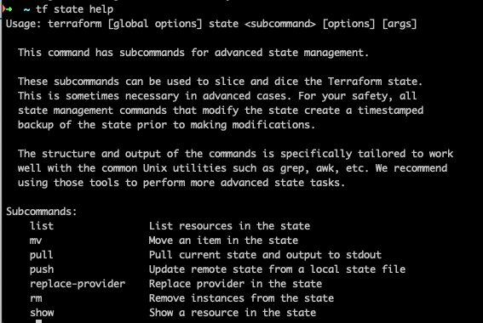
Working with the State: Commands

Slide 51
Demo: Terraform State

Slide 52
Lesson 3: Introduce Terraform
3.4 Learning the Terraform features
Notes:
For your Author Photo, right-click it and select Format Picture. Then select Picture Color and turn the Saturation down to 0%.

Slide 53
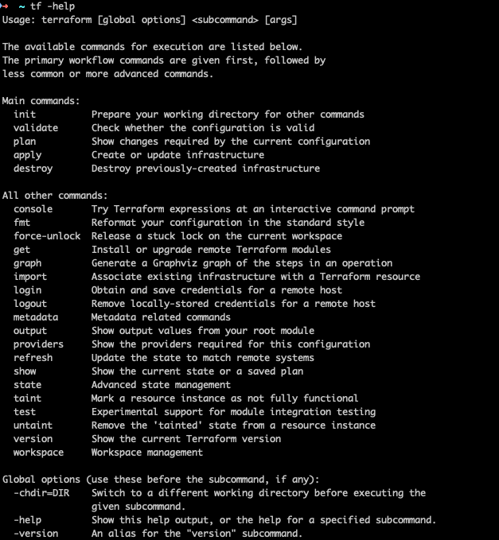
Terraform CLI Features

Slide 54
Lesson 3: Introduce Terraform
3.5 Discover if Terraform is multi-cloud
Notes:
For your Author Photo, right-click it and select Format Picture. Then select Picture Color and turn the Saturation down to 0%.

Slide 55
Is Terraform Multi-Cloud?
Yes!
But…
Providers are cloud specific.
Similar resources are configured very differently.
Configs are not portable.

Slide 56
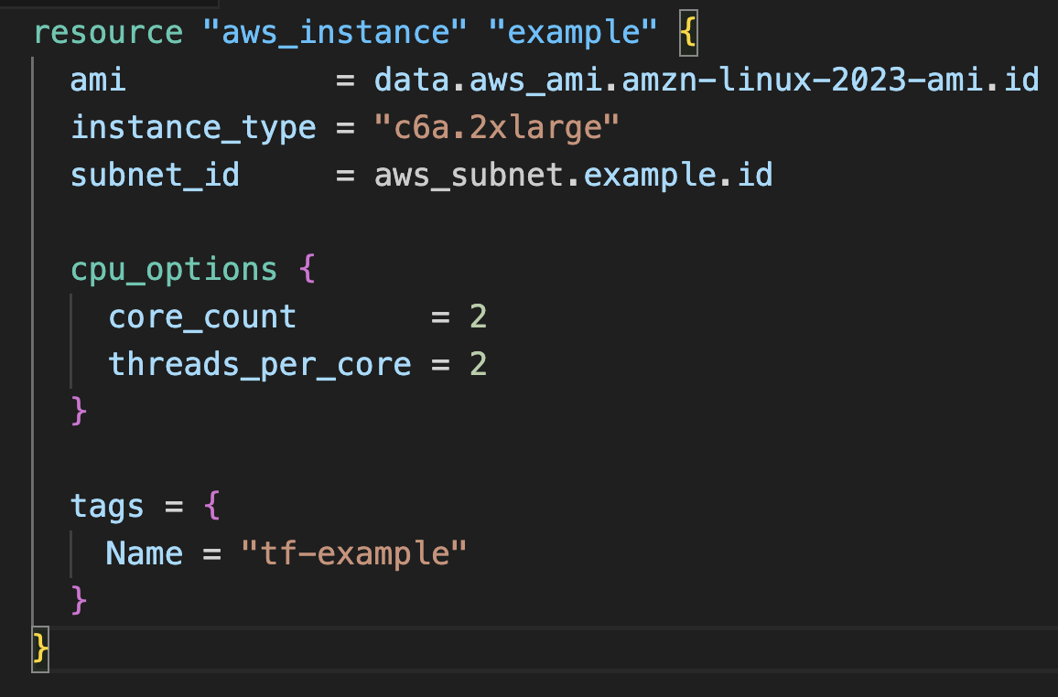
Is Terraform Multi-Cloud?

Slide 57
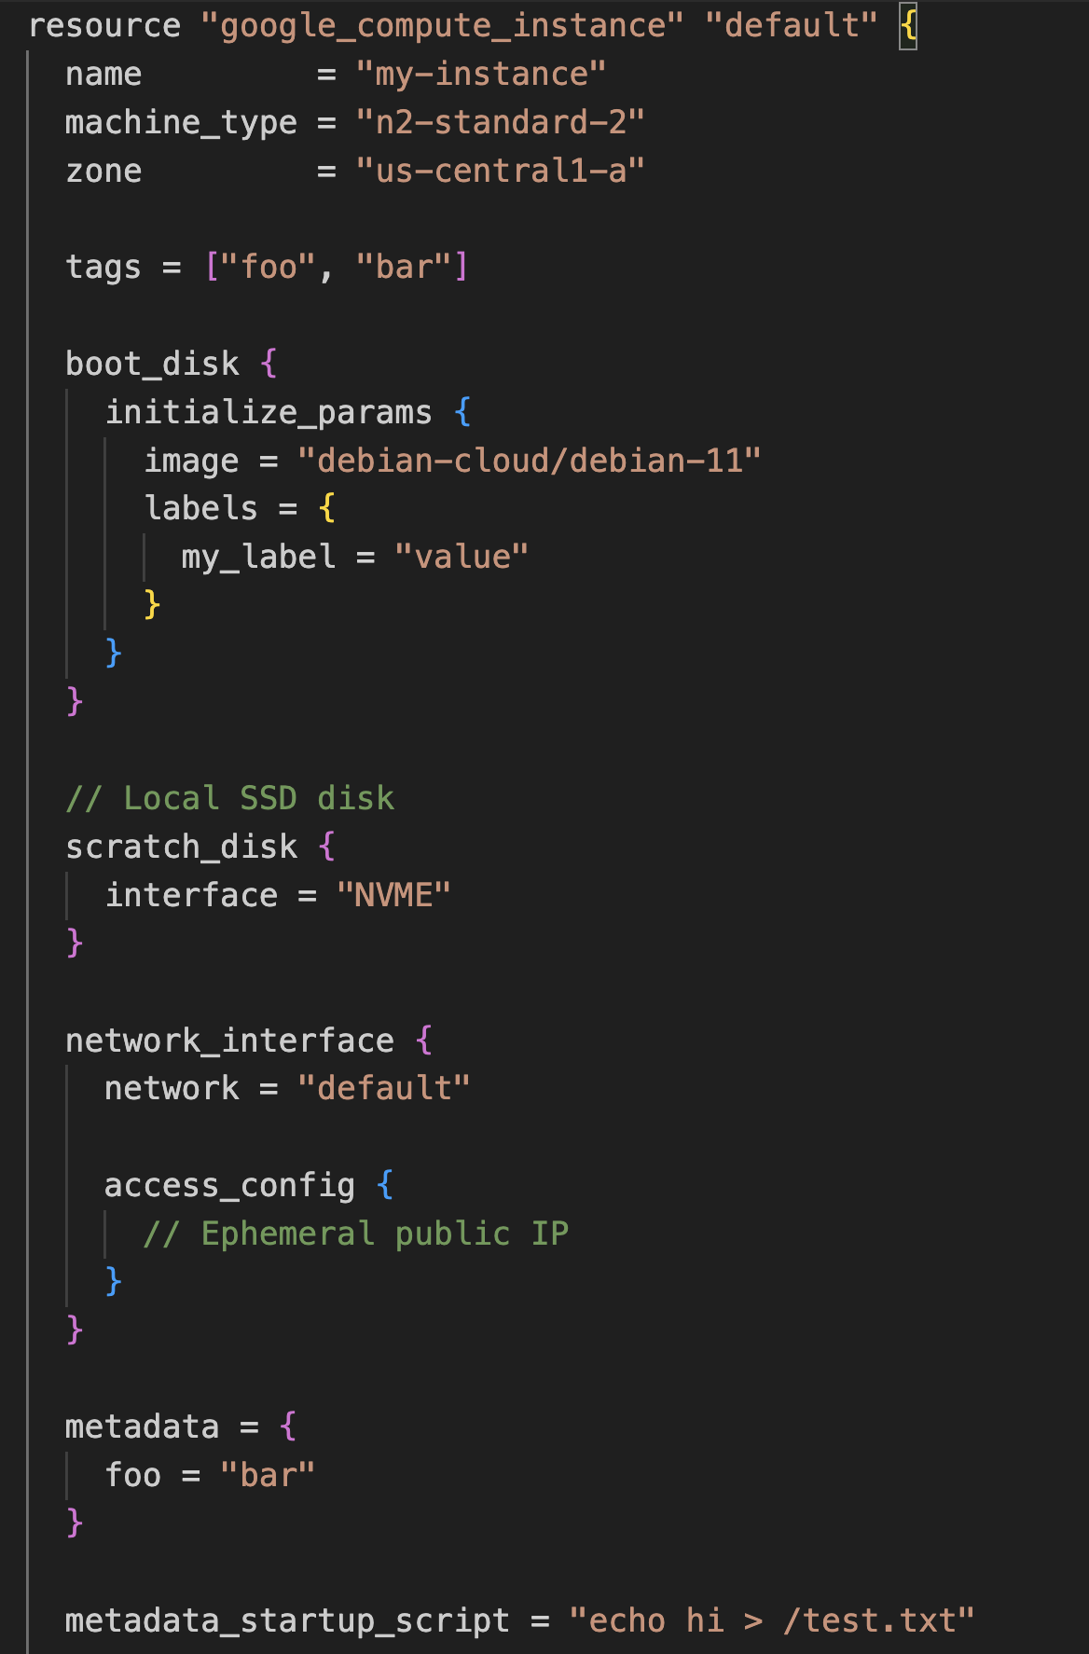
Is Terraform Multi-Cloud?

Slide 58
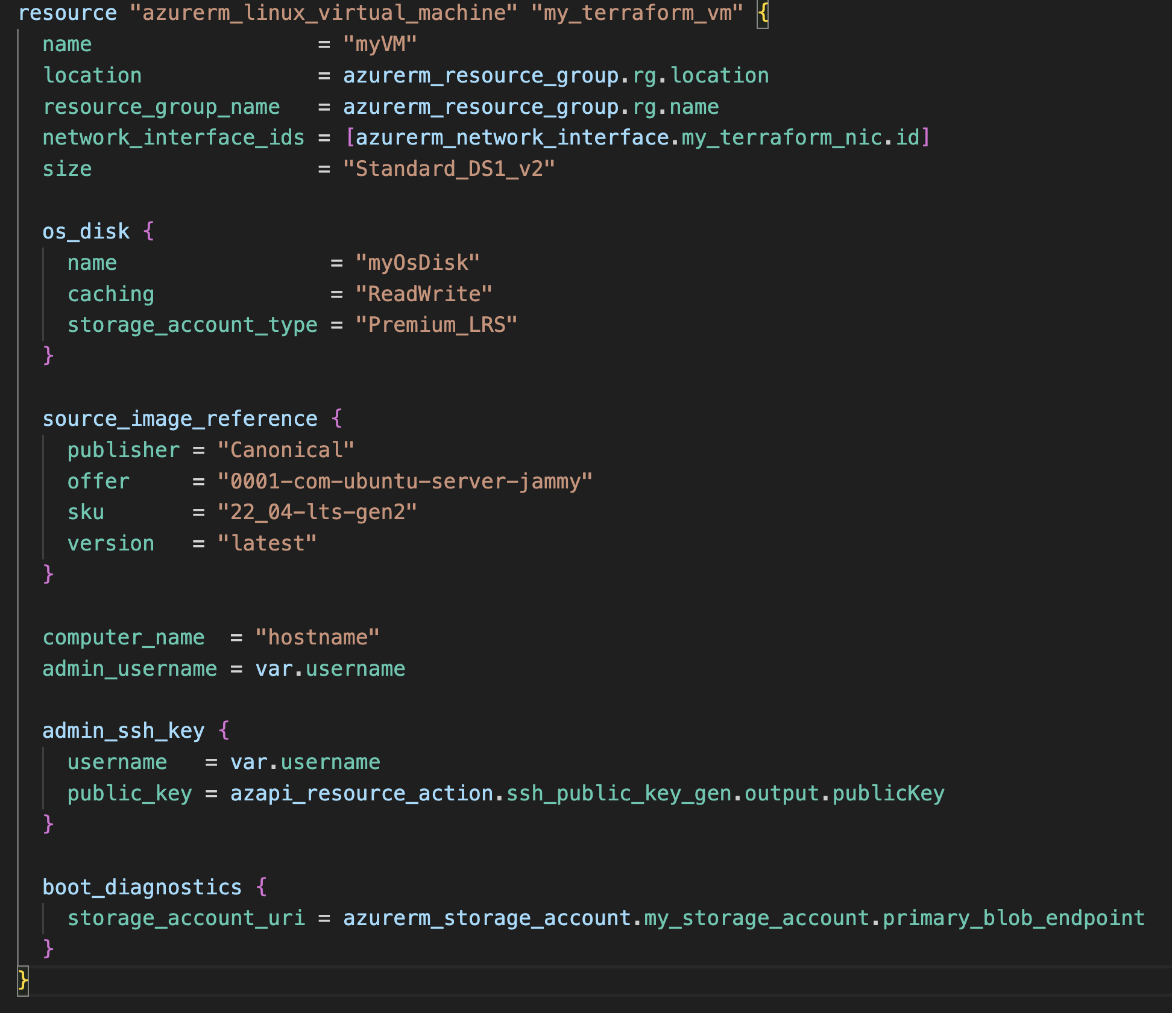
Is Terraform Multi-Cloud?

Slide 59
Lesson 3: Introduce Terraform
3.6 Review: How did “Hello Terraform” work
Notes:
For your Author Photo, right-click it and select Format Picture. Then select Picture Color and turn the Saturation down to 0%.

Slide 60
Demo: Hello Terraform

Slide 61
Lesson 4: Learn HCL
4.1 Learning the basics: Overview of HCL structure
4.2 Learning Terraform providers
4.3 Learning Terraform data sources and resources
4.4 Learning about dependencies in Terraform
4.5 Learning Terraform outputs
4.6 Learning about interpolation in HCL
Notes:
For your Author Photo, right-click it and select Format Picture. Then select Picture Color and turn the Saturation down to 0%.

Slide 62
Lesson 4: Learn HCL
4.1 Learning the basics: Overview of HCL structure
Notes:
For your Author Photo, right-click it and select Format Picture. Then select Picture Color and turn the Saturation down to 0%.

Slide 63
HCL
What is HCL?
Hashicorp Configuration Language
Domain Specific Language
General purpose configuration format
Specific implementations per applications
What uses HCL?
Terraform
Packer
Terrargrunt

Slide 64
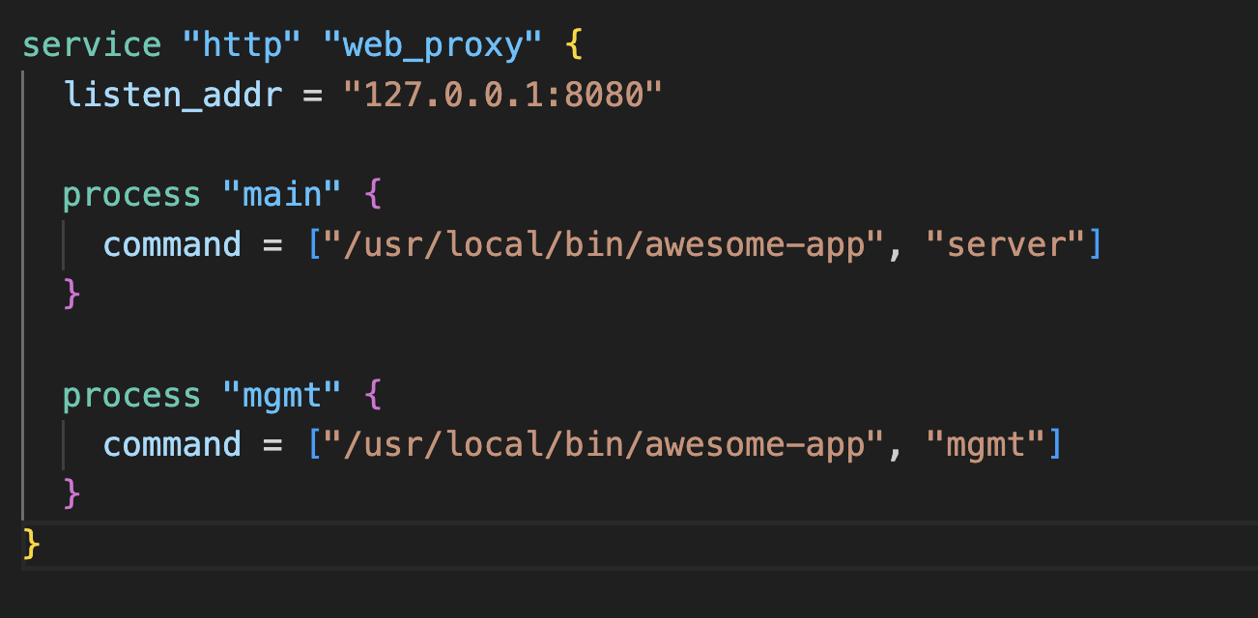
HCL Syntax
Block

Slide 65
HCL Syntax
Type

Slide 66
HCL Syntax
Labels

Slide 67
HCL Syntax
Attributes

Slide 68
Lesson 4: Learn HCL
4.2 Learning Terraform providers
Notes:
For your Author Photo, right-click it and select Format Picture. Then select Picture Color and turn the Saturation down to 0%.

Slide 69
Terraform Providers
Plugins
Interface between Terraform Core and Cloud Service
Implement resources, data sources and functions
General purpose clouds
AWS
GCP
Azure
Other services
GitHub
HTTP
Kubernetes

Slide 70
Provider Configuration
Authentication
Endpoints
Other options
Specific to each provider

Slide 71
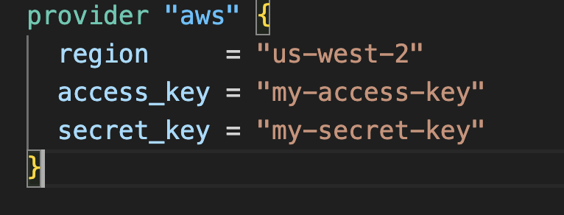
AWS Provider

Slide 72
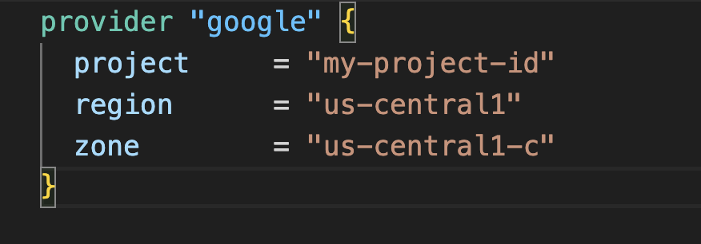
GCP Provider

Slide 73
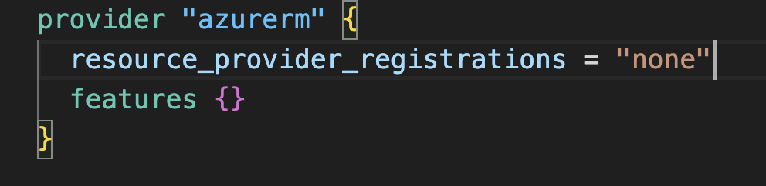
Azure Provider

Slide 74
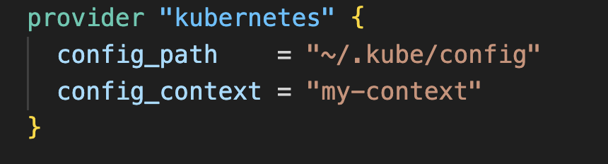
Kubernetes Provider

Slide 75
Provider Configuration
Each providers has specific configuration options
Optional and required configuration
Environment variables or other external configurations
Be aware of credential security

Slide 76
Lesson 4: Learn HCL
4.3 Learning Terraform data sources and resources
Notes:
For your Author Photo, right-click it and select Format Picture. Then select Picture Color and turn the Saturation down to 0%.

Slide 77
Resources and Data Sources
Resources
Objects that are created and managed by Terraform
VM instances
Networking
Storage buckets
Data sources
Objects that are not managed by Terraform but may be referenced
Regions
Availability zones

Slide 78
Lesson 4: Learn HCL
4.4 Learning about dependencies in Terraform
Notes:
For your Author Photo, right-click it and select Format Picture. Then select Picture Color and turn the Saturation down to 0%.

Slide 79
Dependency
Objects in Terraform may depend on one another
Informs Terraform Core of the order to create objects
Dependencies may be implicit or explicit
Examples
A VM depends on networking
A load balancer connection depends on a VM

Slide 80
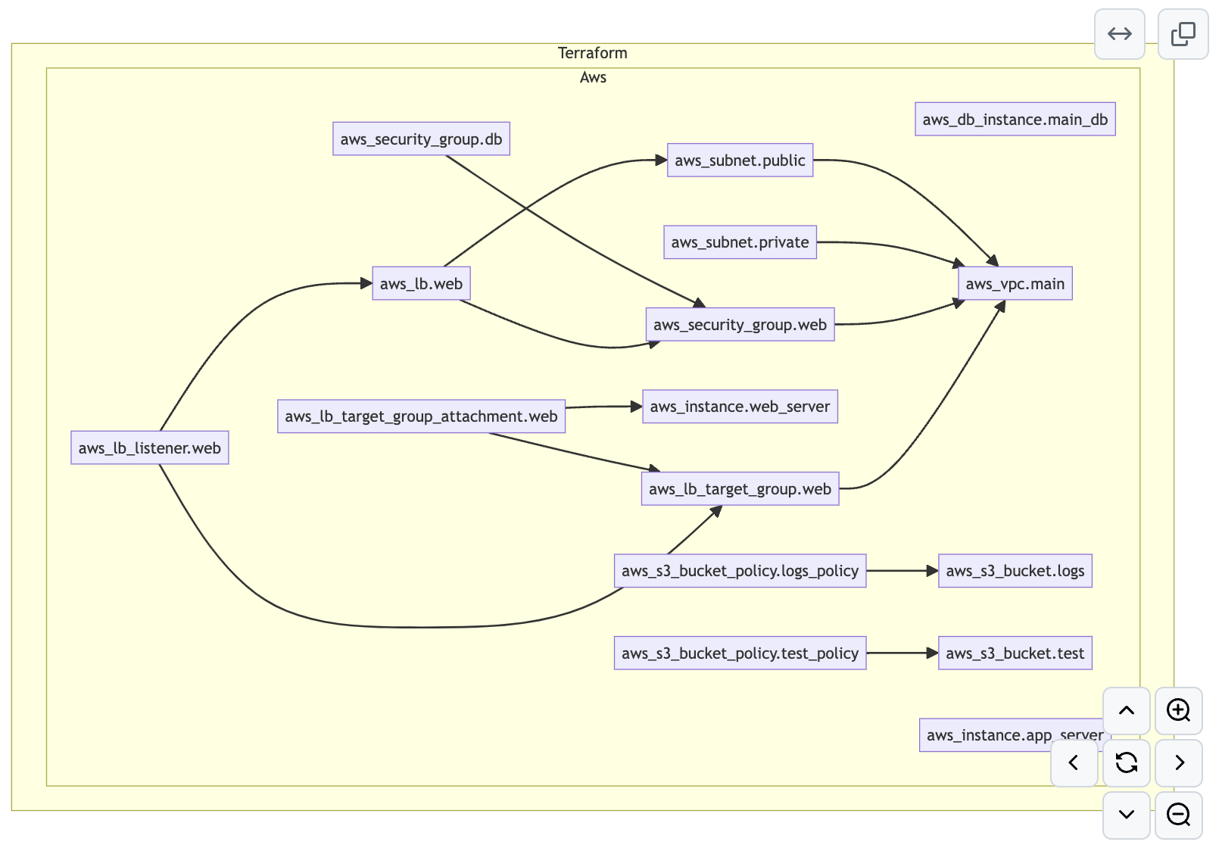
Dependency Graph

Slide 81
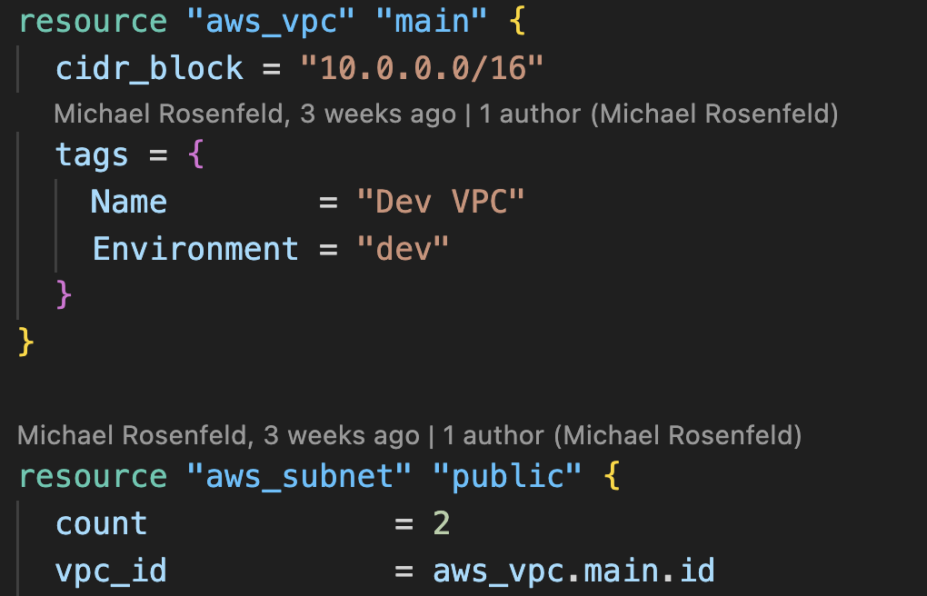
References

Slide 82
Lesson 5: Learn Terraform Providers: Hands-On Activities
5.1 Introducing providers in Terraform
5.2 Working with AWS demo
5.3 Working with GCP demo
5.4 Working with Azure demo
5.5 Using other providers demo
Notes:
For your Author Photo, right-click it and select Format Picture. Then select Picture Color and turn the Saturation down to 0%.

Slide 83
Lesson 5: Learn Terraform Providers: Hands-On Activities
5.1 Introducing providers in Terraform
Notes:
For your Author Photo, right-click it and select Format Picture. Then select Picture Color and turn the Saturation down to 0%.

Slide 84
Lesson 5: Learn Terraform Providers: Hands-On Activities
5.2 Working with AWS demo
Notes:
For your Author Photo, right-click it and select Format Picture. Then select Picture Color and turn the Saturation down to 0%.

Slide 85
Demo: Working with AWS

Slide 86
Lesson 5: Learn Terraform Providers: Hands-On Activities
5.3 Working with GCP demo
Notes:
For your Author Photo, right-click it and select Format Picture. Then select Picture Color and turn the Saturation down to 0%.

Slide 87
Demo: Working with GCP

Slide 88
Lesson 5: Learn Terraform Providers: Hands-On Activities
5.4 Working with Azure demo
Notes:
For your Author Photo, right-click it and select Format Picture. Then select Picture Color and turn the Saturation down to 0%.

Slide 89
Demo: Working with Azure

Slide 90
Lesson 5: Learn Terraform Providers: Hands-On Activities
5.5 Using other providers demo
Notes:
For your Author Photo, right-click it and select Format Picture. Then select Picture Color and turn the Saturation down to 0%.

Slide 91
Demo: Other Providers

Slide 92
Lesson 6: Understand IaC Maturity Model
6.1 Exploring the phases of IaC adoption
Notes:
For your Author Photo, right-click it and select Format Picture. Then select Picture Color and turn the Saturation down to 0%.

Slide 93
Lesson 6: Understand IaC Maturity Model
6.1 Exploring the phases of IaC adoption
Notes:
For your Author Photo, right-click it and select Format Picture. Then select Picture Color and turn the Saturation down to 0%.

Slide 94
Infrastructure as Code Adoption Phases
Manual
Provisioned through a UI or CLI.
Changes do not leave a traceable history and aren't always visible.
Limited or no standards in place.

Slide 95
Infrastructure as Code Adoption Phases
Semi-automated
Provisioned through a combination of UI/CLI, infrastructure as code, and scripts or configuration management.
Limited traceability.
Rollbacks are hard to achieve due to differing record-keeping methods.

Slide 96
Infrastructure as Code Adoption Phases
Infrastructure as code
Infrastructure is provisioned using an IaC tool, such as Terraform.
Provisioning and deployment processes are automated.
Configuration is consistent, with all necessary details fully documented (nothing siloed in a sysadmin's head).
Source files are stored in version control.
Some Terraform code is split into modules to promote consistent reuse of your organization's more common architectural patterns.

Slide 97
Infrastructure as Code Adoption Phases
Collaborative
Users across the organization can safely provision infrastructure without conflicts and with clear understanding of their access permissions.
Expert users within an organization can produce standardized infrastructure templates, and beginner users can consume those to follow infrastructure best practices for the organization.
Per-workspace access control helps committers and approvers on workspaces protect production environments.
Functional groups that don't directly write Terraform code have visibility into infrastructure status and changes.

Slide 98
Lesson 6: Understand IaC Maturity Model
6.2 IaC Maturity Model and Terraform
Notes:
For your Author Photo, right-click it and select Format Picture. Then select Picture Color and turn the Saturation down to 0%.

Slide 99
IaC Maturity Model and Terraform
Terraform Support
Supports and enables all modes of IaC adoption

Slide 100
Lesson 7: Learn Code Re-Use and Encapsulation with Terraform Modules
7.1 Understanding Terraform modules
7.2 Creating a module demo
7.3 Distributing your modules
Notes:
For your Author Photo, right-click it and select Format Picture. Then select Picture Color and turn the Saturation down to 0%.

Slide 101
Lesson 7: Learn Code Re-Use and Encapsulation with Terraform Modules
7.1 Understanding Terraform modules
Notes:
For your Author Photo, right-click it and select Format Picture. Then select Picture Color and turn the Saturation down to 0%.

Slide 102
Terraform Modules
What is a module?
Logical grouping of Terraform resources
Contained in a directory
May be local or remote
Like a library

Slide 103
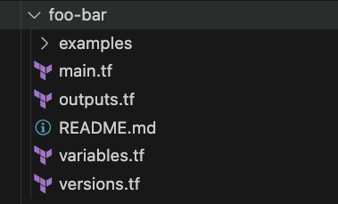
Terraform Modules
Code layout

Slide 104
Lesson 7: Learn Code Re-Use and Encapsulation with Terraform Modules
7.2 Creating a module demo
Notes:
For your Author Photo, right-click it and select Format Picture. Then select Picture Color and turn the Saturation down to 0%.

Slide 105
Demo: Create a Module

Slide 106
Lesson 7: Learn Code Re-Use and Encapsulation with Terraform Modules
7.3 Distributing your modules
Notes:
For your Author Photo, right-click it and select Format Picture. Then select Picture Color and turn the Saturation down to 0%.

Slide 107
Module Distribution
Distribution Methods
Filesystem
VCS
Registry

Slide 108
Module Distribution
Filesystem
Modules are stored in directories.
May be embedded in other modules (submodules).

Slide 109
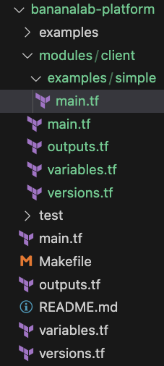
Module Distribution
Filesystem

Slide 110
Module Distribution
VCS
Stored directly in Version Control System.
May be versioned.

Slide 111
Module Distribution
VCS
Mono repo
All modules share version
Better for composition
Multi repo
Versioned independently

Slide 112
Module Distribution
Registry
Sourced from VCS
Public or private
Enhanced versioning
Better discoverability

Slide 113
Module Types
Module types
Low level
Wraps a few related resources
Used to standardize resources
Examples:
S3 Bucket
VPC
High level
Composed of low-level modules
Sometimes called “Components” or “Patterns”
Examples:
Load balanced application

Slide 114
Lesson 8: Learn Collaboration with Terraform
8.1 Understanding Terraform backends
8.2 Understanding Terraform workspaces
8.3 Using Terraform in multi-team environments
Notes:
For your Author Photo, right-click it and select Format Picture. Then select Picture Color and turn the Saturation down to 0%.

Slide 115
Lesson 8: Learn Collaboration with Terraform
8.1 Understanding Terraform backends
Notes:
For your Author Photo, right-click it and select Format Picture. Then select Picture Color and turn the Saturation down to 0%.

Slide 116
Backends
Backends
Remote storage
Accessible everywhere Terraform is run
Locking
NOT VCS

Slide 117
Backends
Backends
AWS S3
GCS
Azure Blob
Terraform Cloud
HTTP (GitLab)

Slide 118
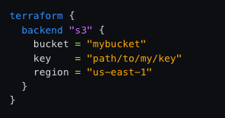
Backends
Configuration

Slide 119
Lesson 8: Learn Collaboration with Terraform
8.2 Understanding Terraform workspaces
Notes:
For your Author Photo, right-click it and select Format Picture. Then select Picture Color and turn the Saturation down to 0%.

Slide 120
Workspaces
Workspaces
Multiple states from the same configuration
Enables deployment stages
Differences controlled by inputs

Slide 121
Lesson 8: Learn Collaboration with Terraform
8.3 Using Terraform in multi-team environments
Notes:
For your Author Photo, right-click it and select Format Picture. Then select Picture Color and turn the Saturation down to 0%.

Slide 122
Collaboration
Collaboration
Publish re-usable modules
Version modules
Test modules
Use remote backend
Automate deployments
Make deployments visible

Slide 123
Lesson 9: Discover Continuous Integration and Deployment with Terraform
9.1 Understanding Terraform and version control systems (VCS)
9.2 Ensuring code quality and compliance
9.3 Testing Terraform code
9.4 Exploring Terraform Cloud
9.5 Exploring Atlantis Demo
Notes:
For your Author Photo, right-click it and select Format Picture. Then select Picture Color and turn the Saturation down to 0%.

Slide 124
Lesson 9: Discover Continuous Integration and Deployment with Terraform
9.1 Understanding Terraform and version control systems (VCS)
Notes:
For your Author Photo, right-click it and select Format Picture. Then select Picture Color and turn the Saturation down to 0%.

Slide 125
Version Control
Repository types
Modules
Contains one or more re-usable shared modules
Referenced by “live” repos or other modules
Versions maintained by tagged commits

Slide 126
Version Control
Repository types
Live
Creates resources
State associated
Represents desired state of infrastructure
Single source of truth
References module repos

Slide 127
Lesson 9: Discover Continuous Integration and Deployment with Terraform
9.2 Ensuring code quality and compliance
Notes:
For your Author Photo, right-click it and select Format Picture. Then select Picture Color and turn the Saturation down to 0%.

Slide 128
Continuous Integration
Continuous Integration
A software development practice where developers frequently merge their code changes into a shared repository. Each integration is automatically built and tested, allowing teams to detect issues early and ensure that the codebase remains in a working state and adheres to standard coding practices.

Slide 129
Continuous Integration
Continuous Integration
Applies to modules only
Triggered by pull requests
Examples:
Unit tests
Compliance checks
Linters

Slide 130
Continuous Deployment
Continuous Deployment
A software development practice in which code changes are automatically deployed to production as soon as they pass the automated testing phase. It extends the process of Continuous Integration by taking it one step further—automating the release of every successful code update.

Slide 131
Continuous Deployment
Continuous Deployment
Applies to Live repos only
Triggered by merge

Slide 132
Lesson 9: Discover Continuous Integration and Deployment with Terraform
9.3 Testing Terraform code
Notes:
For your Author Photo, right-click it and select Format Picture. Then select Picture Color and turn the Saturation down to 0%.

Slide 133
Demo: Testing Terraform Modules

Slide 134
Lesson 9: Discover Continuous Integration and Deployment with Terraform
9.4 Exploring Terraform Cloud
Notes:
For your Author Photo, right-click it and select Format Picture. Then select Picture Color and turn the Saturation down to 0%.

Slide 135
Demo: Exploring Terraform Cloud

Slide 136
Lesson 9: Discover Continuous Integration and Deployment with Terraform
9.5 Exploring Atlantis demo
Notes:
For your Author Photo, right-click it and select Format Picture. Then select Picture Color and turn the Saturation down to 0%.

Slide 137
Demo: Exploring Atlantis

Slide 138
Lesson 10: Extend Terraform
10.1 Learning about custom providers
Notes:
For your Author Photo, right-click it and select Format Picture. Then select Picture Color and turn the Saturation down to 0%.

Slide 139
Lesson 10: Extend Terraform
10.1 Learning about custom providers
Notes:
For your Author Photo, right-click it and select Format Picture. Then select Picture Color and turn the Saturation down to 0%.

Slide 140
Custom Providers
Custom Providers
Written in GO
Add functionality to Terraform
Custom resources, data sources, and functions

Slide 141
Demo: Custom Providers

Slide 142
Lesson 10: Extend Terraform
10.2 Custom Provider code overview
Notes:
For your Author Photo, right-click it and select Format Picture. Then select Picture Color and turn the Saturation down to 0%.

Slide 143
Demo: Custom Provider code review

Slide 144
Lesson 11: Review and Next Steps
11.1 Reviewing what we learned
11.2 Understanding what’s next
Notes:
For your Author Photo, right-click it and select Format Picture. Then select Picture Color and turn the Saturation down to 0%.

Slide 145
Lesson 11: Review and Next Steps
11.1 Reviewing what we learned
Notes:
For your Author Photo, right-click it and select Format Picture. Then select Picture Color and turn the Saturation down to 0%.

Slide 146
What have we learned?
Basic principles of Infrastructure as Code:
Advantages of IaC
Evolution of Infrastructure management
Declarative vs Imperative
Terraform
Setting up a development environment
Features
Syntax

Slide 147
What have we learned?
Modules
Types of modules
Re-use
Publishing
Testing
CI
Live
Single source of truth
State
Workspaces
CD

Slide 148
What have we learned?
Extending Terraform
Custom providers

Slide 149
Lesson 11: Review and Next Steps
11.2 Understanding what’s next
Notes:
For your Author Photo, right-click it and select Format Picture. Then select Picture Color and turn the Saturation down to 0%.

Slide 150
What’s next?
Create a small module that deploys some resources.
Create a sandbox account with your cloud provider.
Explore modules in the public registry to understand how they work.
Join online communities like r/terraform on Reddit.
Set up repositories for modules and live environments.

